Slide 1

Introduction
ERD
DFD
Data
Dictionary
DDL
Gantt
Chart
Live
Demo
Stock Prediction
Page | 01

Slide 2
Introduction
ERD
DFD
Data
Dictionary
DDL
Gantt
Chart
Live
Demo
Introduction
Rationale
Thales Stock Predictor project is to offer valuable insights to current shareholders of Thales and potential investors by forecasting the company's stock prices using predictive modeling techniques. This would enable informed investment decisions, leveraging data and analytics to understand future stock price movements and inform stock holding decisions.
Scope
the project encompasses the entire process of developing the stock predictor, from creating project documentation like the charter and data flow diagrams to backend development with a DDL script and predictive modeling. It also includes task automation using SQL Server Integration Services (SSIS) for data extraction, transformation, loading, and model integration, as well as creating reports and visualizations to present findings to stakeholders. The intended outcomes are to guide shareholders in making decisions about their stock holdings and to inform prospective investors about the potential of Thales's stock as an investment opportunity
Page | 02

Slide 3
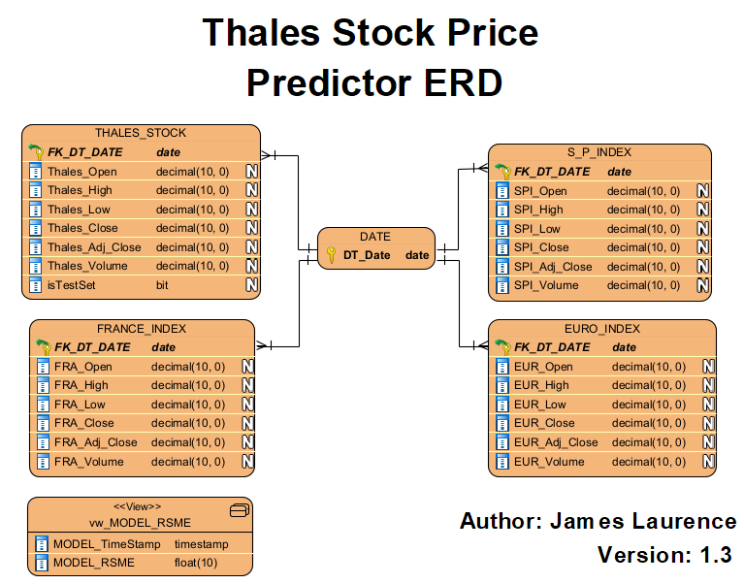
Introduction
ERD
DFD
Data
Dictionary
DDL
Gantt
Chart
Live
Demo
Entity Relationship Diagram
Tables
Page | 03

Slide 4
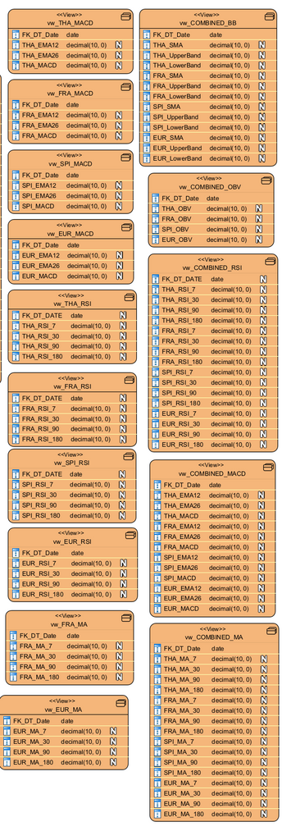
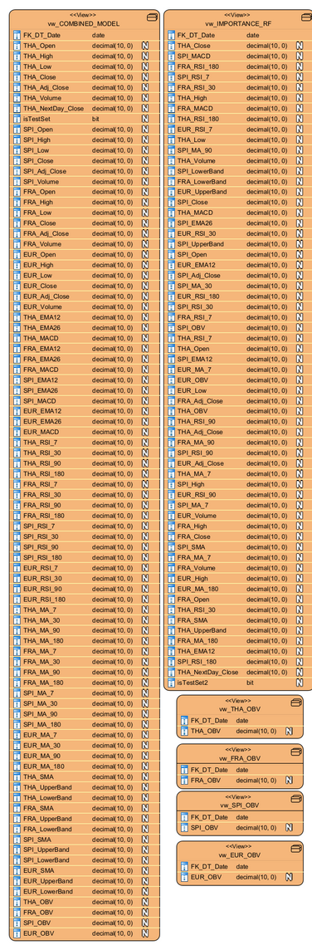
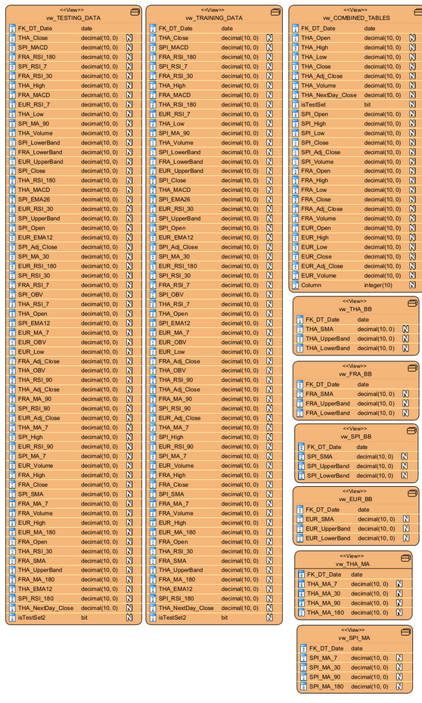
Introduction
ERD
DFD
Data
Dictionary
DDL
Gantt
Chart
Live
Demo
Entity Relationship Diagram
Views
Page | 04

Slide 5
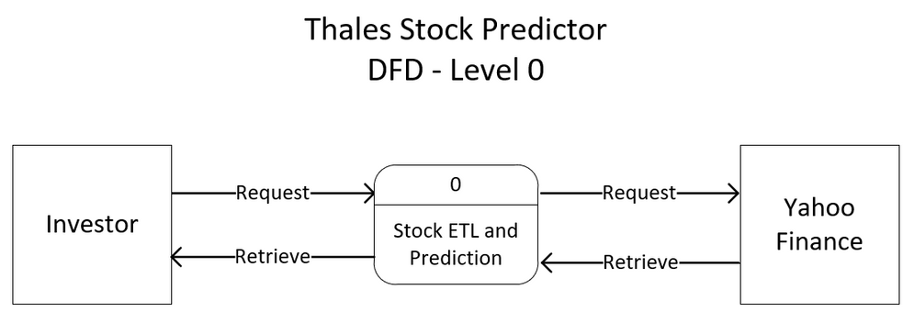
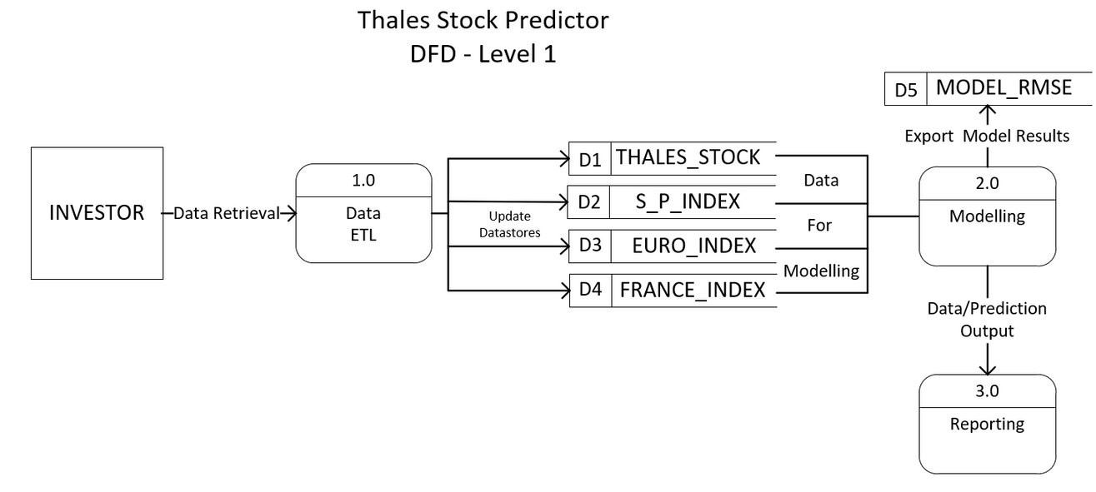
Introduction
ERD
DFD
Data
Dictionary
DDL
Gantt
Chart
Live
Demo
Data Flow
Diagram
Level 0
Level 1
Page | 05

Slide 6
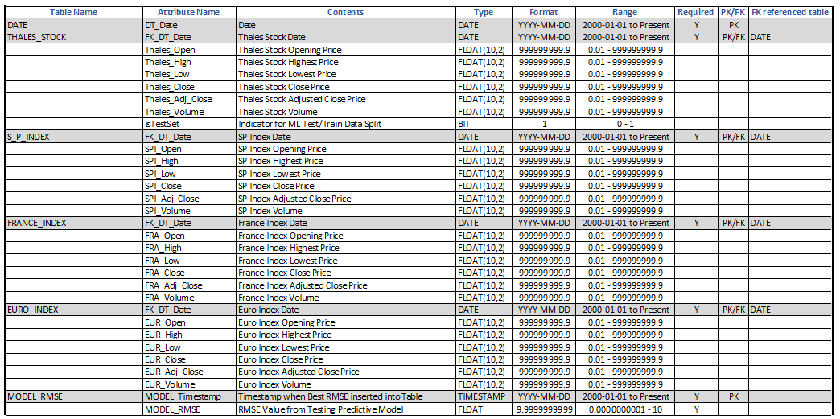
Introduction
ERD
DFD
Data
Dictionary
DDL
Gantt
Chart
Live
Demo
Data Dictionary
Page | 06

Slide 7
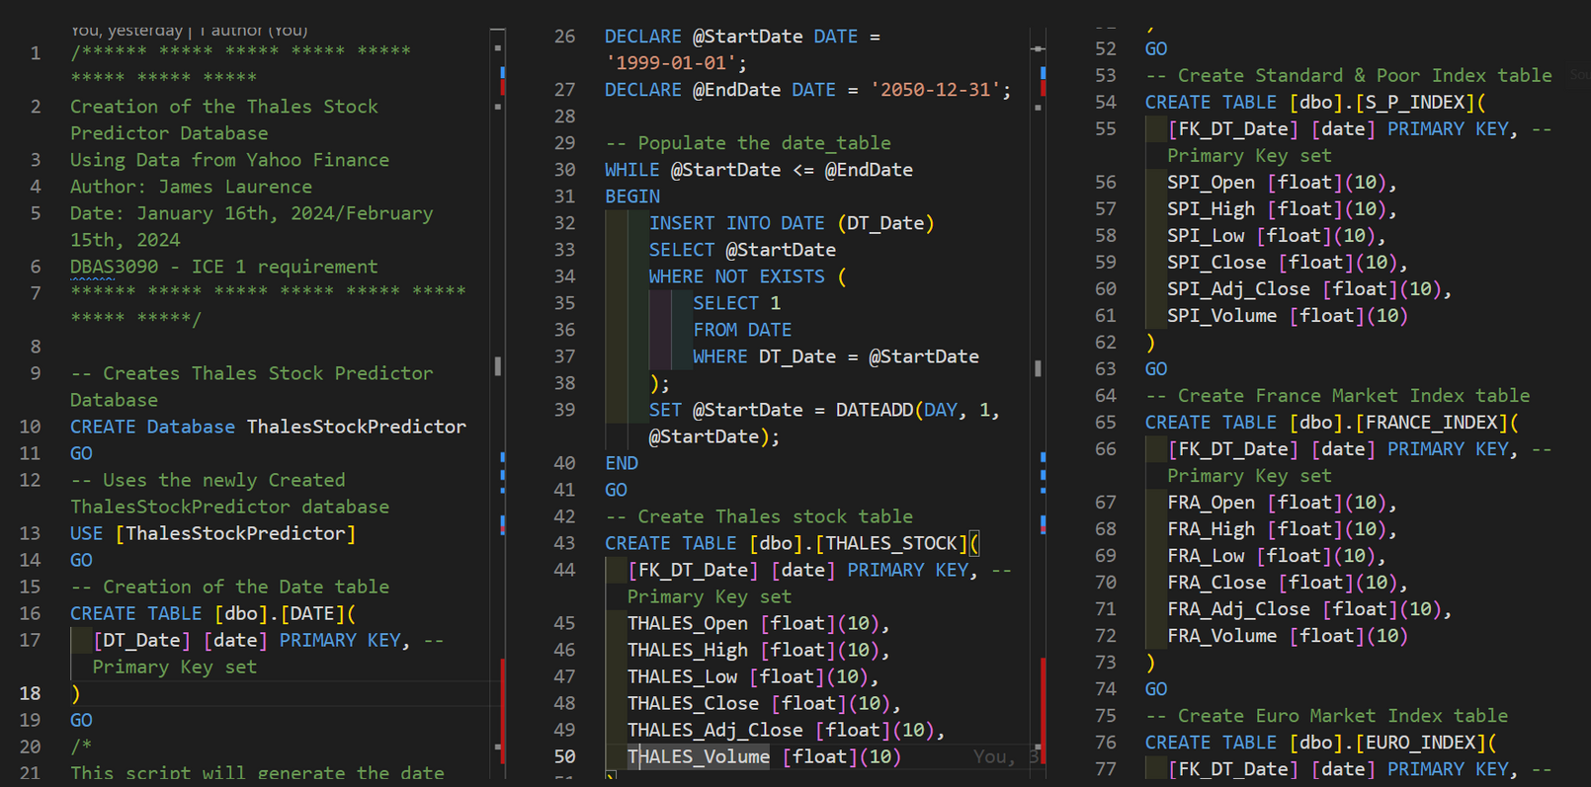
Introduction
ERD
DFD
Data
Dictionary
DDL
Gantt
Chart
Live
Demo
Database Schema
Script
Page | 07

Slide 8
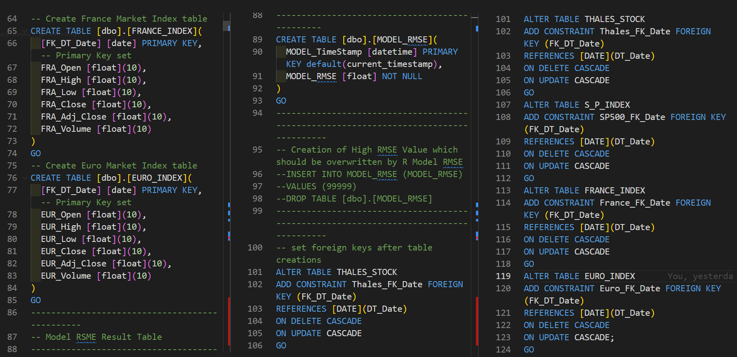
Introduction
ERD
DFD
Data
Dictionary
DDL
Gantt
Chart
Live
Demo
Database Schema
Script
Page | 08

Slide 9
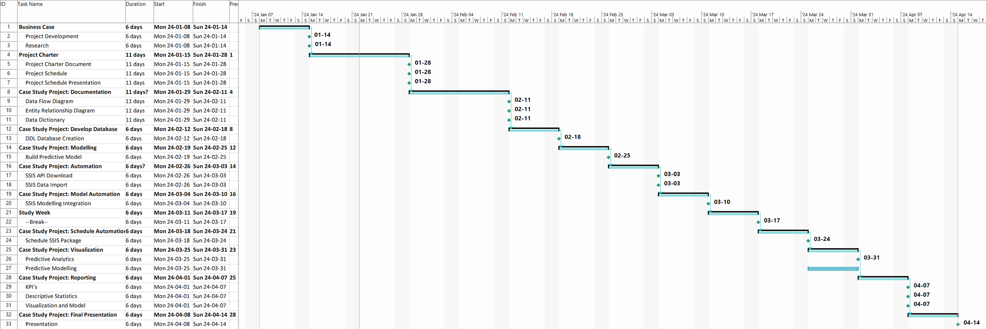
Introduction
ERD
DFD
Data
Dictionary
DDL
Gantt
Chart
Live
Demo
Gantt Chart
Page | 09

Slide 10
Introduction
ERD
DFD
Data
Dictionary
DDL
Gantt
Chart
Live
Demo
Live Demo
Page |10

Slide 11
Introduction
ERD
DFD
Data
Dictionary
DDL
Gantt
Chart
Live
Demo
Thank You
Questions?
Page | 11

